Slide 1

Hospital System

Slide 2
Team Members
Name : Mahmoud Ahmed Alam Eldin ID :221101068
Name : Mohamed Salah Hussein ID :221101083
Name : Kareem Ahmed Rabea Amer ID :221101042

Slide 3
The Project Idea :
This Hospital Management System Project integrates user account creation, login authentication, and patient registration. It ensures secure password and username verification. The appointment system allows patients to schedule and manage appointments, with role-based access for medical staff. The services module includes access to medical articles and information, categorized by medical departments. The system employs a centralized database for secure storage and retrieval of patient and appointment data

Slide 4
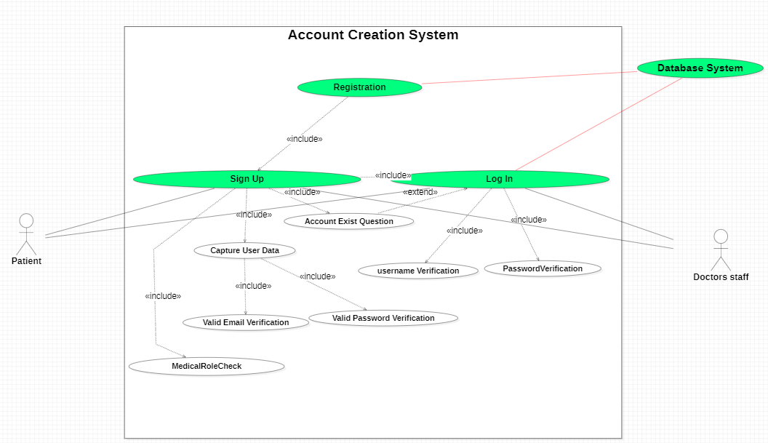
UseCase 1 (Account Creation System)

Slide 5
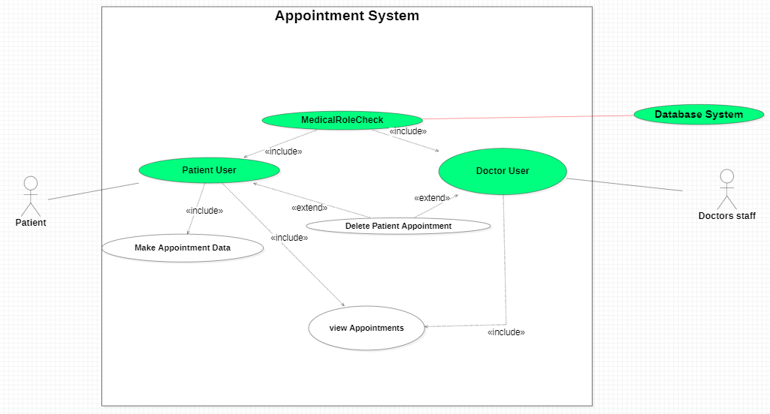
UseCase 2 (Appointment System)

Slide 6
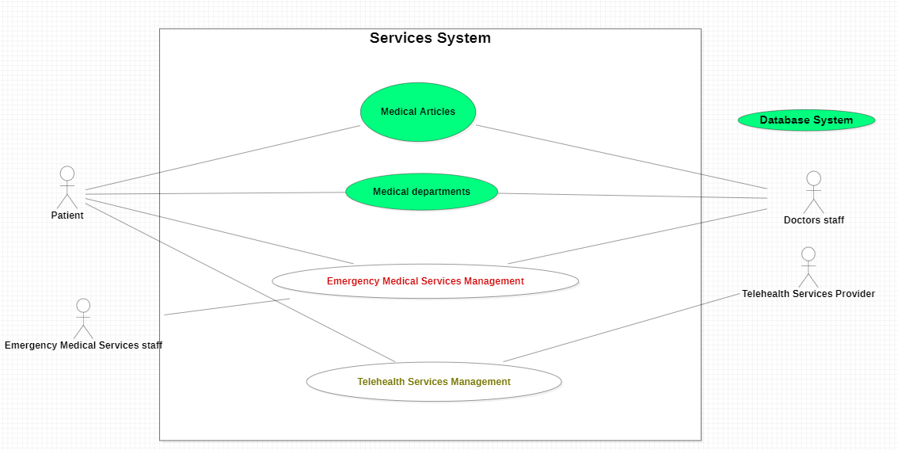
UseCase 3 (Services System)

Slide 7
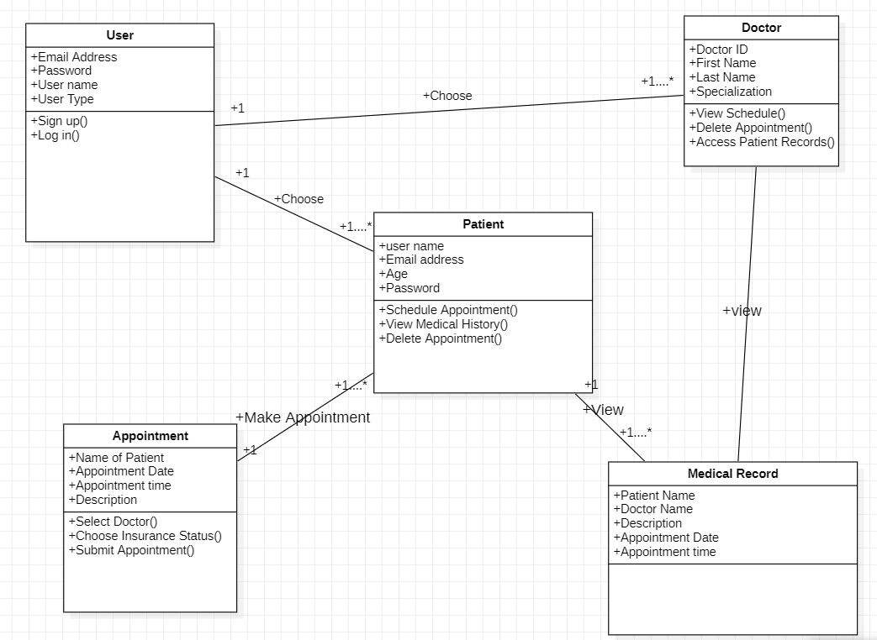
Class Diagram

Slide 8
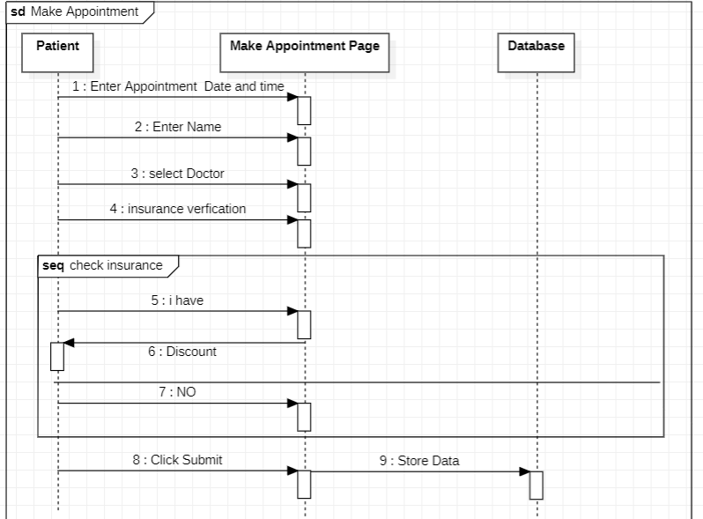
Sequence Diagram

Slide 9
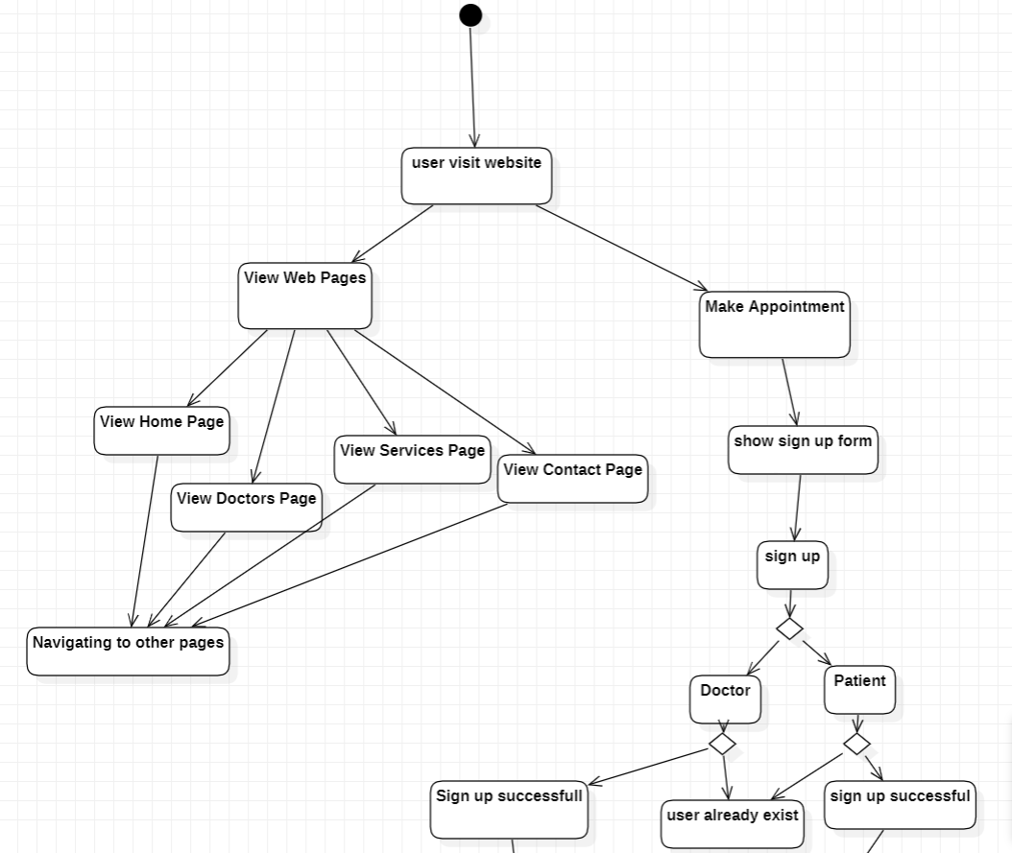
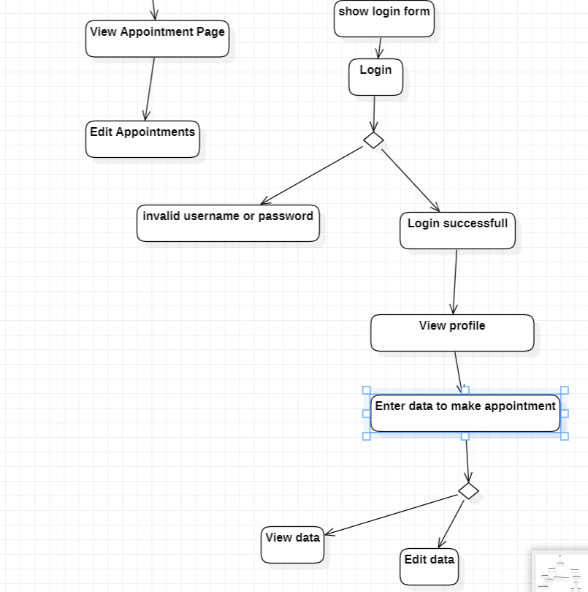
Activity Diagram

Slide 10
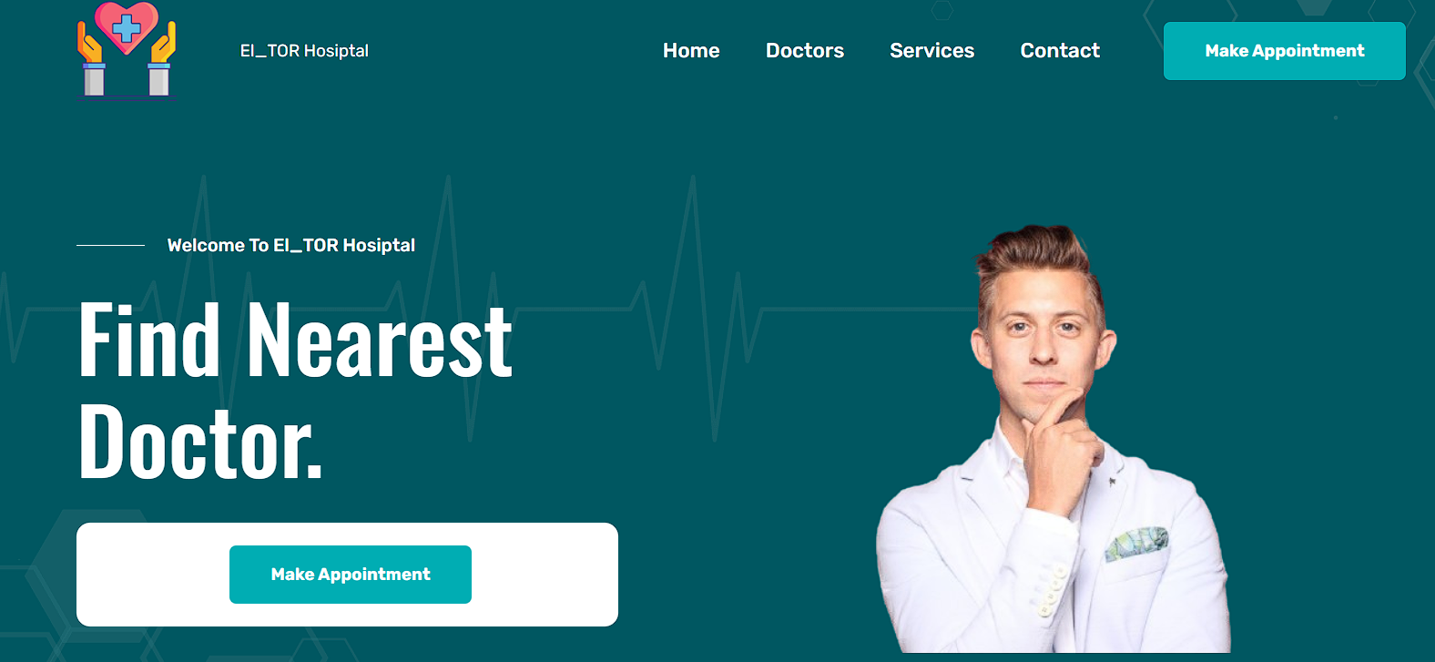
Header & Home Page

Slide 11

Doctors Page

Slide 12
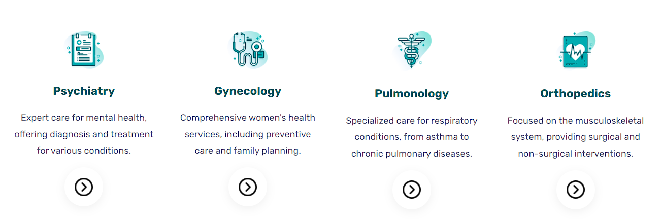
Services Page

Slide 13
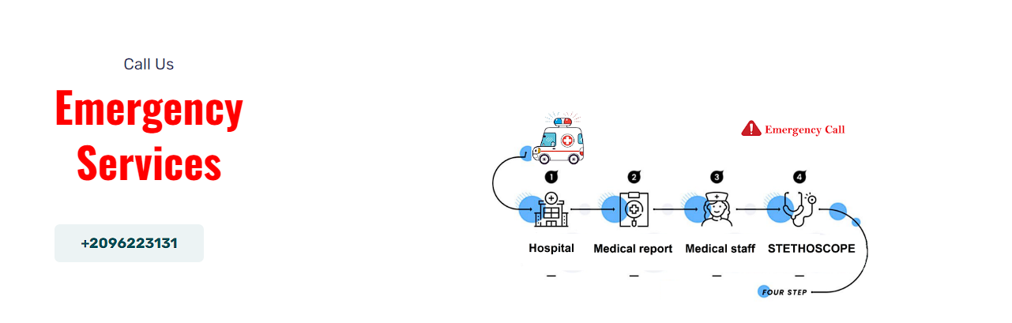
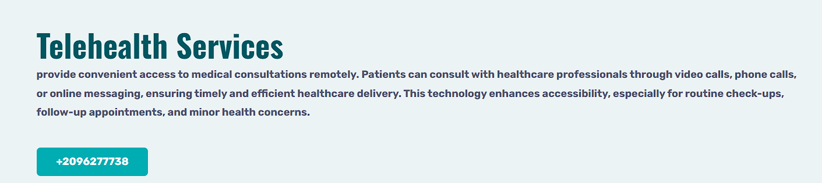
Contact Page

Slide 14
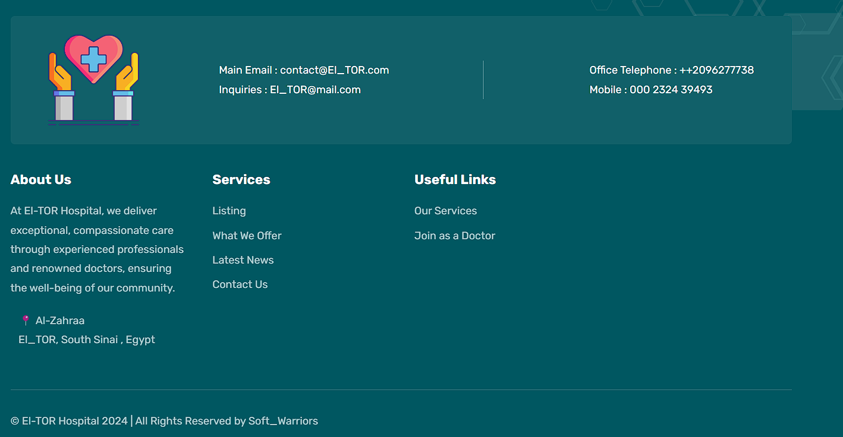
Footer

Slide 15
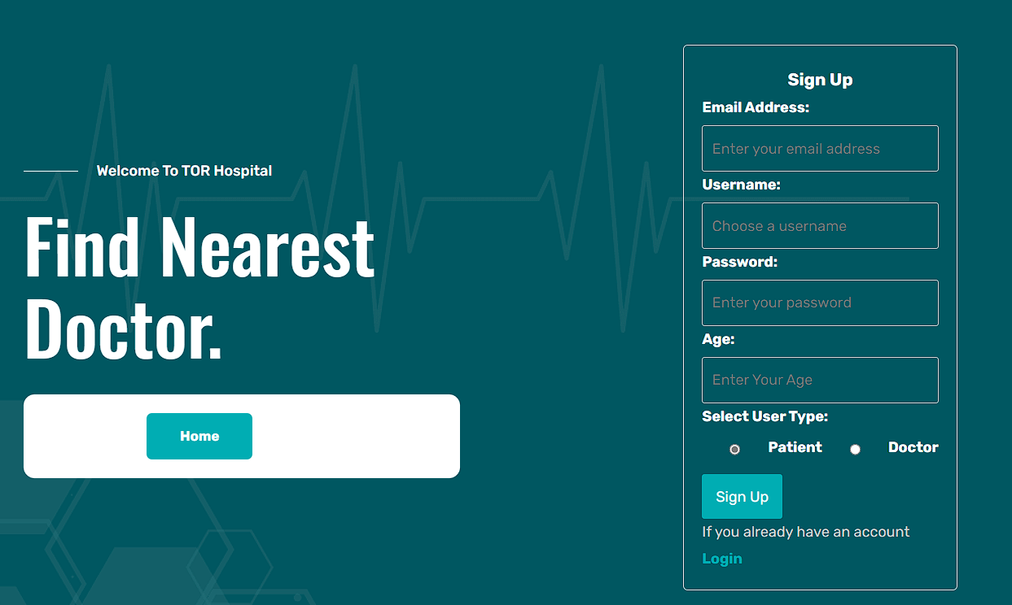
Make Appointment (Sign up Page)

Slide 16
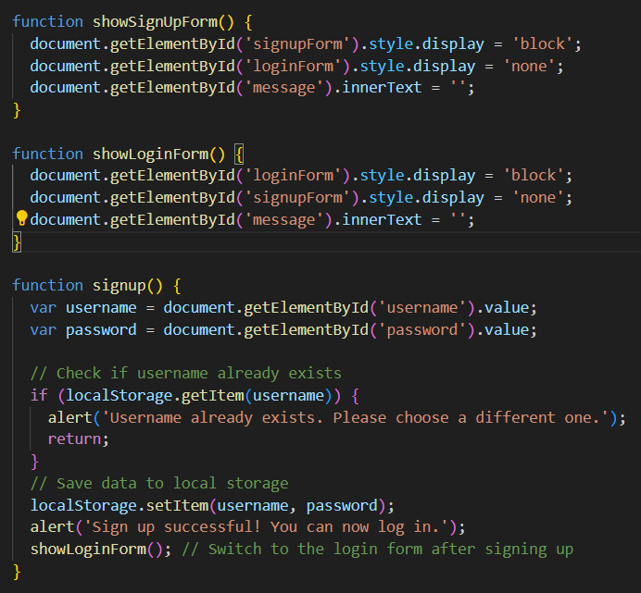
Java Script code for sign up page

Slide 17
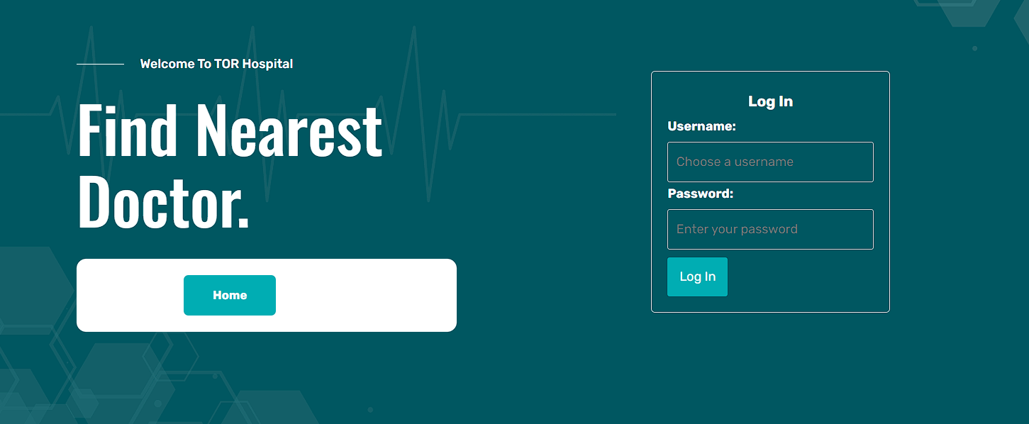
Login Page

Slide 18
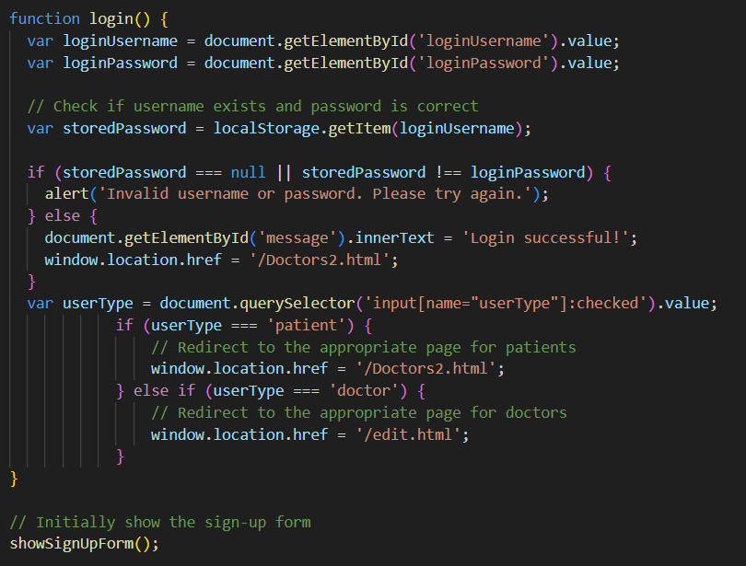
Java Script Code For Login Page

Slide 19

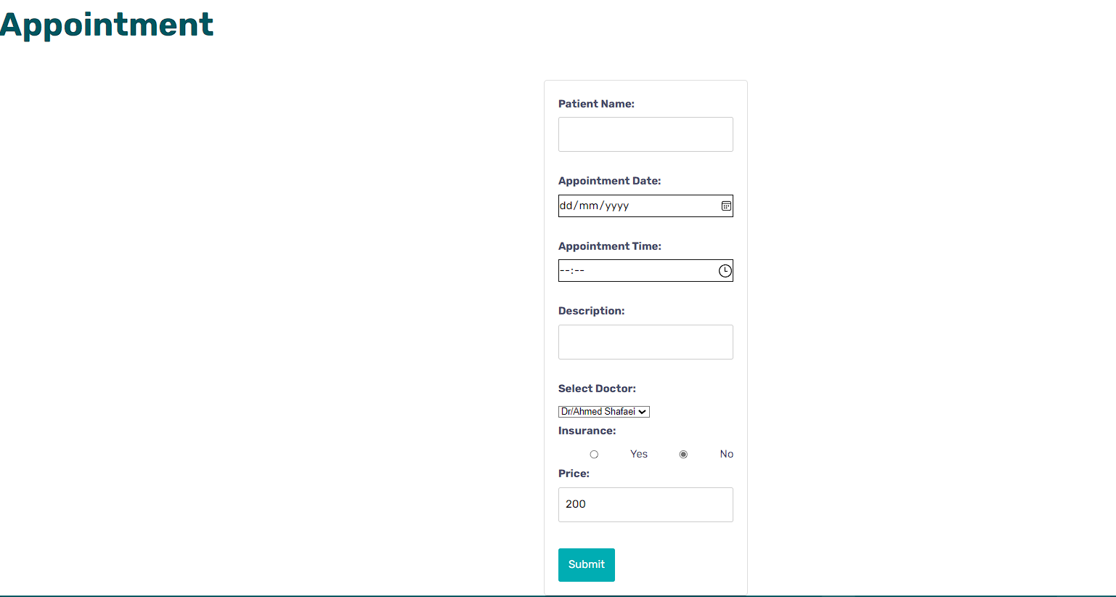
Profile Page for patient & appointment

Slide 20
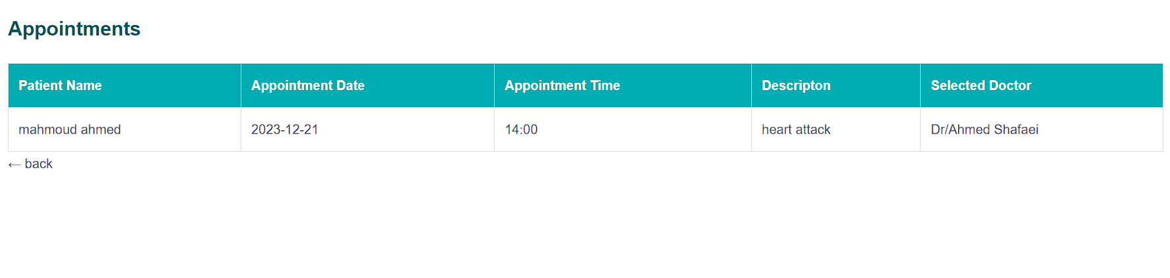
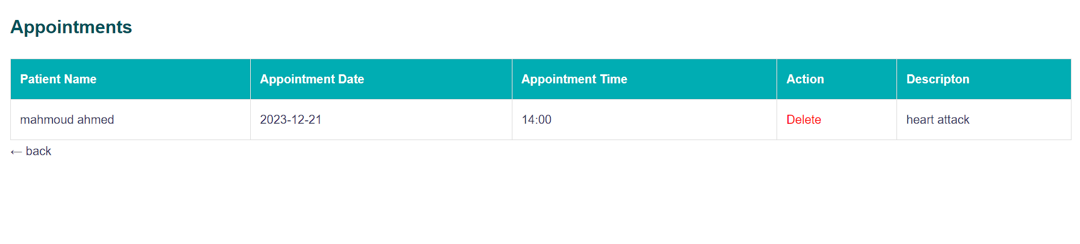
View & Edit Data Page

